Slide 1
Misleading Data on
Video Games
Assignment 4: Lie with Data
Arnav Dashaputra

Slide 2
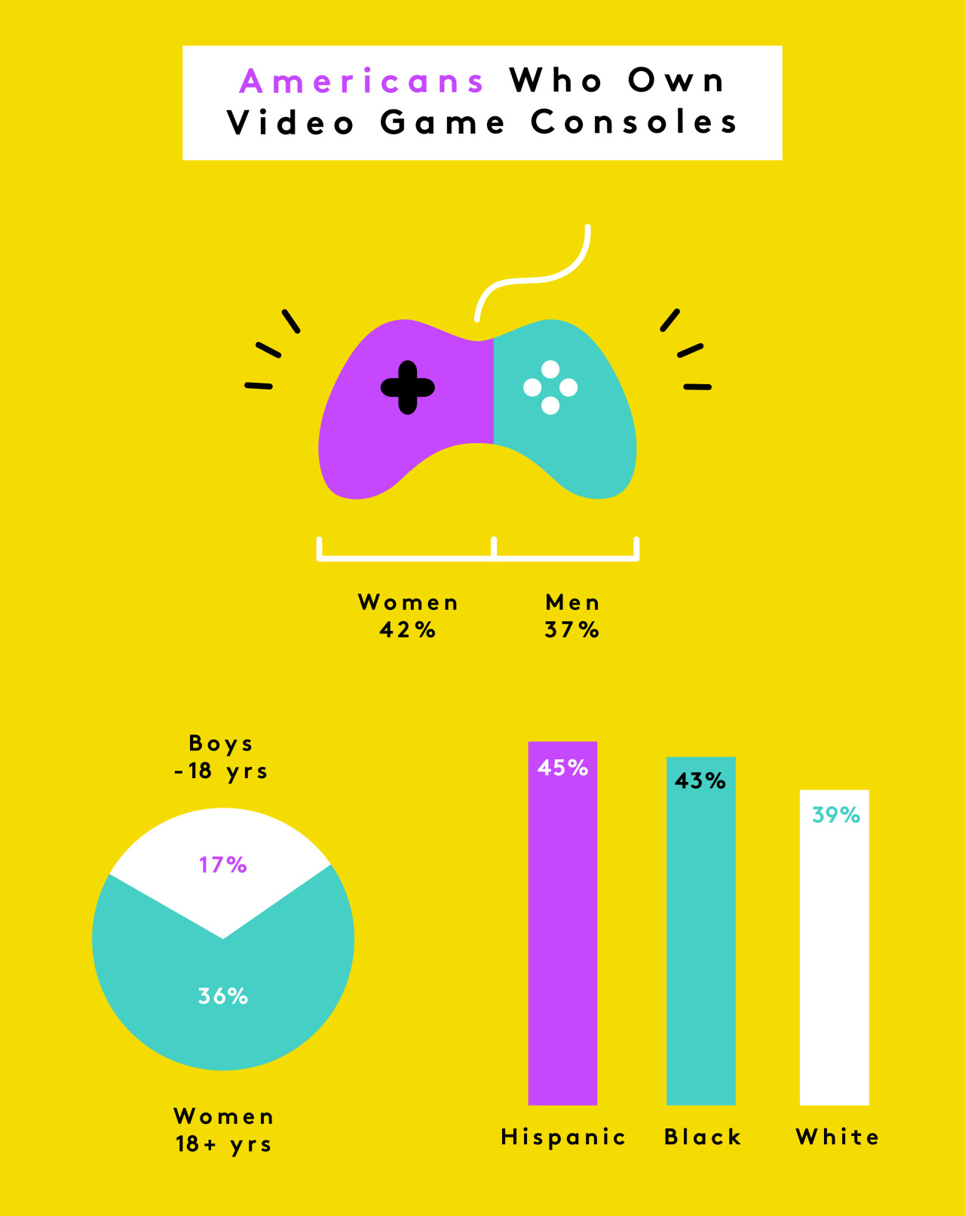
Americans Who Own Video Game Consoles
Original article found (Refinery29) - Current source (r/dataisugly)
There are glaringly obvious mistakes made in this infographic. Beginning at the top, their gender assignment chart does not add up to a whole of 100%. There may have been omitted data on unknown or other genders, and did not end up being represented here. Next, there is a pie chart that involves data that is not relevant at all. It is comparing boys under 18 years of age to women over 18 years of age; comparing both gender and age while also simultaneously not adding up to 100%. The larger portion of the pie takes up around 75% of the whole but reports to only be 36%. The smaller section is also inaccurate, taking up around 33% in reality but reporting only 17%. Lastly, I feel that the demographic chart can have some reasoning behind it, especially because people can have multiple ethnicities and can therefore fall under multiple categories. However, there were many globally large ethnicities omitted. This data was most likely made to draw attention to the disparities between demographics of video game console owners.
In order to fix these issues, the first chart should account for unknown or other genders and should add up to 100%. The pie chart should also, in my opinion, either be entirely removed or change focuses. The comparison being made is not useful to any reader. Lastly, it would have been nice to see the sample population sizes in the bar chart, as well as a consideration of other ethnicities.

Slide 3
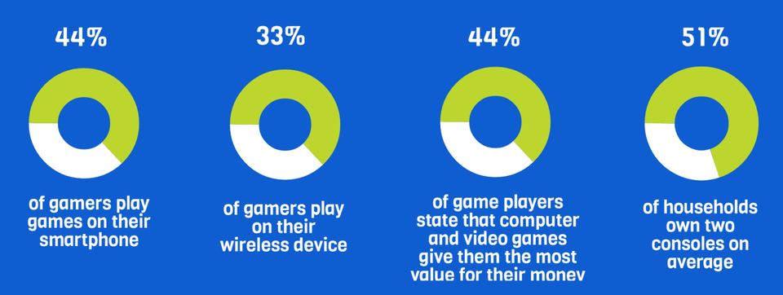
Video Game Survey Results
Original article lost (Tumblr) - Current source (r/dataisugly)
All four of these donut charts (pie chart without the center) are very inaccurate. Firstly, on none of these charts do the ratio of filled-to-empty match the percentage reading above them. Worse, there is redundancy, leading to evidence of inaccurate data. The first two donut charts are explaining similar things, as a smartphone is a wireless device, but the percentage of gamers on wireless devices is smaller than those that play on just their smartphone. This data should either be reviewed, or there should be made a distinction between what a wireless device is, and a smartphone, which is known to all as a wireless device. Additionally, for the third chart, there is no context given to the data being shown. There is a comparison being made between the value of video games and the value of other types of games, but those types of games were never highlighted. The data was most likely reported in this way to show the ratios of people that fit under certain categories in comparison to those that do not fit under them, but was not able to do it in an effective way.

